Slide 1
Value of Information Security Assessments
Heather Couturier
Weber State University
2018 HELUG Conference
Notes:
Welcome Everyone! I am Heather Couturier, Access Systems Specialist with Weber State University.
Importance of security – it’s what we do
Today’s presentation is about the values of utilizing information security auditing processes to help protect our institutions,
also known as….

Slide 2
Attack of the
White Hats!
Image Credit: Chris Whetzel
Notes:
The Attack of the White Hats!!
The terror of knowing your system has been compromised
It never feels good knowing someone has found and exploited a weakness, but with the right mindset I can assure you

Slide 3
Information Security Assessments
Getting hacked can be a good thing.
Notes:
Getting hacked can be a good thing
The diversity of our group is a strength
Some of this presentation will seem basic to some people
No system is hack-proof (at least not yet, comparable to infomercials and magic diets)
Ingenuity & curiosity of the hacker brain paired with amazing technological skills
There will always be someone to challenge the system.

Slide 4
White Hat Hackers
Ethical Hackers
Help protect computer networks
Often employed as network security specialists
Sometimes hired as a contractor or consultant
Help to locate weaknesses in a system
before they can be exploited by others.
Notes:
This can be expensive, and it’s crucial you’re dealing with people or organizations you can trust.

Slide 5
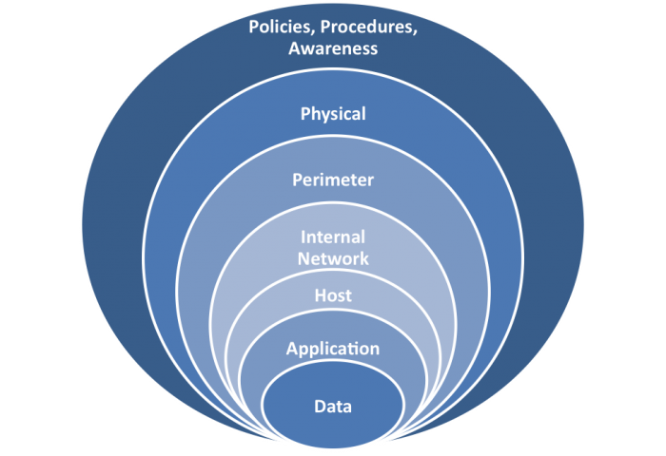
Defense in Depth
The Goal:
To buy an institution time to handle an attack.
Notes:
-Because nothing is hack-proof, it’s important to consider Defense in Depth
Physical access control and IT access control are directly related.
Multiple Layers of Security Controls
Covering personnel, procedural, technical and physical
The goal is to buy an institution time to handle an attack, but this leads us to a new question

Slide 6
Are We Vulnerable?
Recognizing weaknesses and vulnerabilities within our own systems can be extremely difficult.
Notes:
The simple answer is YES
It’s natural for us to avoid them – no one wants to be weak, vulnerable, etc.

Slide 7
Risk is Always Present
Malicious hackers
Employee fraud
Hardware failure
Facility destruction
And Others!

Slide 8
The Balancing Act
Resources dictate approaches to security
Cost Effectiveness
Balance of
Security demands
Control costs
Procedures
Return on investment for security systems
Notes:
This can be expensive, and it’s crucial you’re dealing with people or organizations you can trust.

Slide 9
A Unique Solution
Beginning in 2007, Utah higher education chose to take a proactive stance on information security by evaluating each institutions’ IT security systems.
Notes:
UEN and 3 universities participated
Utilized models from institutions in Arizona
And recommendations from NIST, National Institute of Standards & Technology

Slide 10
One ‘Mean’ Team
Team of higher education IT professionals from each participating institution perform assessments.
Team members do not assess their own institution.
Higher education has employees possessing technical expertise, providing performance of the necessary tests at a reasonable cost.

Slide 11
Comprehensive Assessments
Assessments review the implementation of core IT security practices.
Security Policies
Security Awareness & Training
Physical Security
Incident Handling
Identification & Authentication
Logical Access Controls
Cryptography

Slide 12
The Assessment Begins
Assessments are periodic and unannounced.
Prior to arriving at the institution, in depth penetration testing is performed remotely to determine potential areas that may need further investigation.

Slide 13
The Assessment Continues
Once on the campus, team members test specific system vulnerabilities.
The team is typically on-site for four-to-five days, attempting to penetrate various systems, evaluating physical security, & meeting with campus staff regarding system configurations.

Slide 14
Assessment Conclusion
On the final day, the team provides a brief overview of their findings to key IT personnel and other technical staff.
Within the next month, the team provides a detailed final report which includes information specific to each institution’s security needs and issues.

Slide 15
Some Notes & Reminders
High Security Areas
PIN Visibility
Unique Alarms (Brute force alarms, etc.)
Education: ISO, University Standards & Policies
Password Strength
Generic Accounts (Passwords & permissions)
OS Updates
Remote Access
Notes:
Dual Authentication & Door handles

Slide 16
Some Notes & Reminders
Unattended Computers
Dual Logon Authentication (DUO, etc.)
Permissions Restrictions for Users
Admin vs User: Use and Logon
Single Sign-on
Credential Weaknesses
RFID Blocking Badge Holders
FIPS 201 Approved
Group Suggestions & Recommendations?
Notes:
Dual Authentication & Door handles

Slide 17
Thanks!
Any questions?
You can find me at:
HeatherCouturier@weber.edu

