Slide 1

Lenel 7.3 Upgrade
HELUG 2018
Jose Rocha
Jonathan Randolph
Stanford University

Slide 2
STANFORD UNIVERSITY
  93% of undergraduates live
  on campus
6,200+ externally sponsored research projects
  9,368
  graduate students
7,062 undergrad
students
  2,219
  faculty members
Established 1885
Opened Doors 1891
  4:1
  8,180 contiguous acres
  ~700
  major buildings
  (15.3 million sq. feet)
  117 National Championships (NCAA Division 1)
  $1.64 billion
  total research budget
  $24.8 billion
  endowment
  (as of Aug. 31, 2017)
  student
  to faculty ratio
  7
  Schools: Business, Earth Sciences, Education, Engineering, Humanities and Sciences, Law, Medicine
  For 42 years in a row, Stanford has won at least one NCAA championship – the longest streak in the nation.
  19 current Nobel laureates (31 total)
  4 Pulitzer Prize winners
  16 National Medal of Science recipients
  2 Presidential Medal of Freedom winners
  Source: http://facts.stanford.edu/pdf/StanfordFacts_2018.pdf
Notes:
Stanford info – location, # students, etc.

Slide 3
LENEL 7.3 UPGRADE
CRITERIA
Several Revisions Behind
Future OpenAccess
Lenel 7.3 Software Update
HID Integration
Custom Solutions: Email Notifications and Access Level Upload Tools
SCOPE

Slide 4

LENEL 7.3 UPGRADE
https://youtu.be/o0CXUv-xxtY

Slide 5
LENEL 7.3 UPGRADE
Set, ready, go!

Slide 6

Information Security Office
Information Security Office standards:
TLS 1.0 and older protocols.
Lenel 6.6 and part of Lenel 7.3 built with .Net 3.5.
Entire project encompassed security focus/standards.

Slide 7
Information Security Office
TOOLS
IISCrypto
Nmap
Qualys Scans
Systems Administrators
ISO Office
SYSTEMS

Slide 8
Information Security Office
IIS Crytpo Demo

Slide 9


CHALLENGES
Number of builds before going live?

Slide 10

BUGS/DEFECTS
Lenel 7.3 build did not include Stanford’s hotfixes!

Slide 11
1^{st BUILD}
7.3.345 Update 1 .67 sub build. Two revisions:
DLL failure due to not checking for .NET 3.5.1.
Utility.dll issue login attempt issue required updated copy.

Slide 12
2nd BUILD
7.3.345 Update 2:
1) Failed due to no Onity feature.

Slide 13
3rd and 4th BUILD
7.3.345 Update 2 sub build 440:
Partial build.
Full installation bundled, testing stopped due to 3 issues: memory error, alarm monitoring and critical LNL 1320 defect.

Slide 14
5th BUILD
7.3.345 Update 2 sub build 443:
1) Memory issue and alarm monitoring persisted.
“Out of memory!”

Slide 15

6th BUILD
7.3.345 Update 3 sub build 611:
Windows Print Service disabled threw misleading memory issue.
LS Event Context Service Provider restart failed.
7.3.345.611 - HID fails to connect with TLS 1.0 disabled.

Slide 16
7th BUILD
7.3.345.634 - HID works with TLS 1.1 and TLS 1.2.

Slide 17
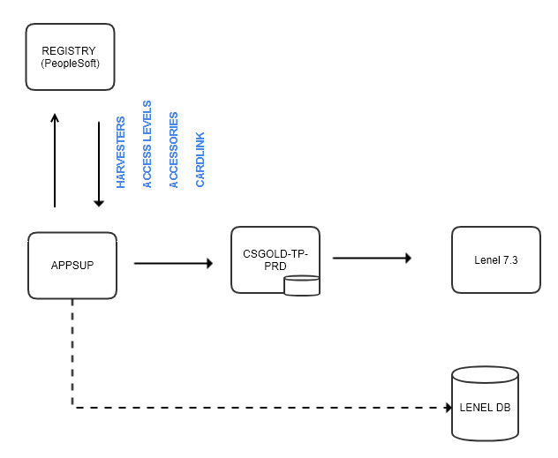
IMPLEMENTATION
Stanford Integrations

Slide 18
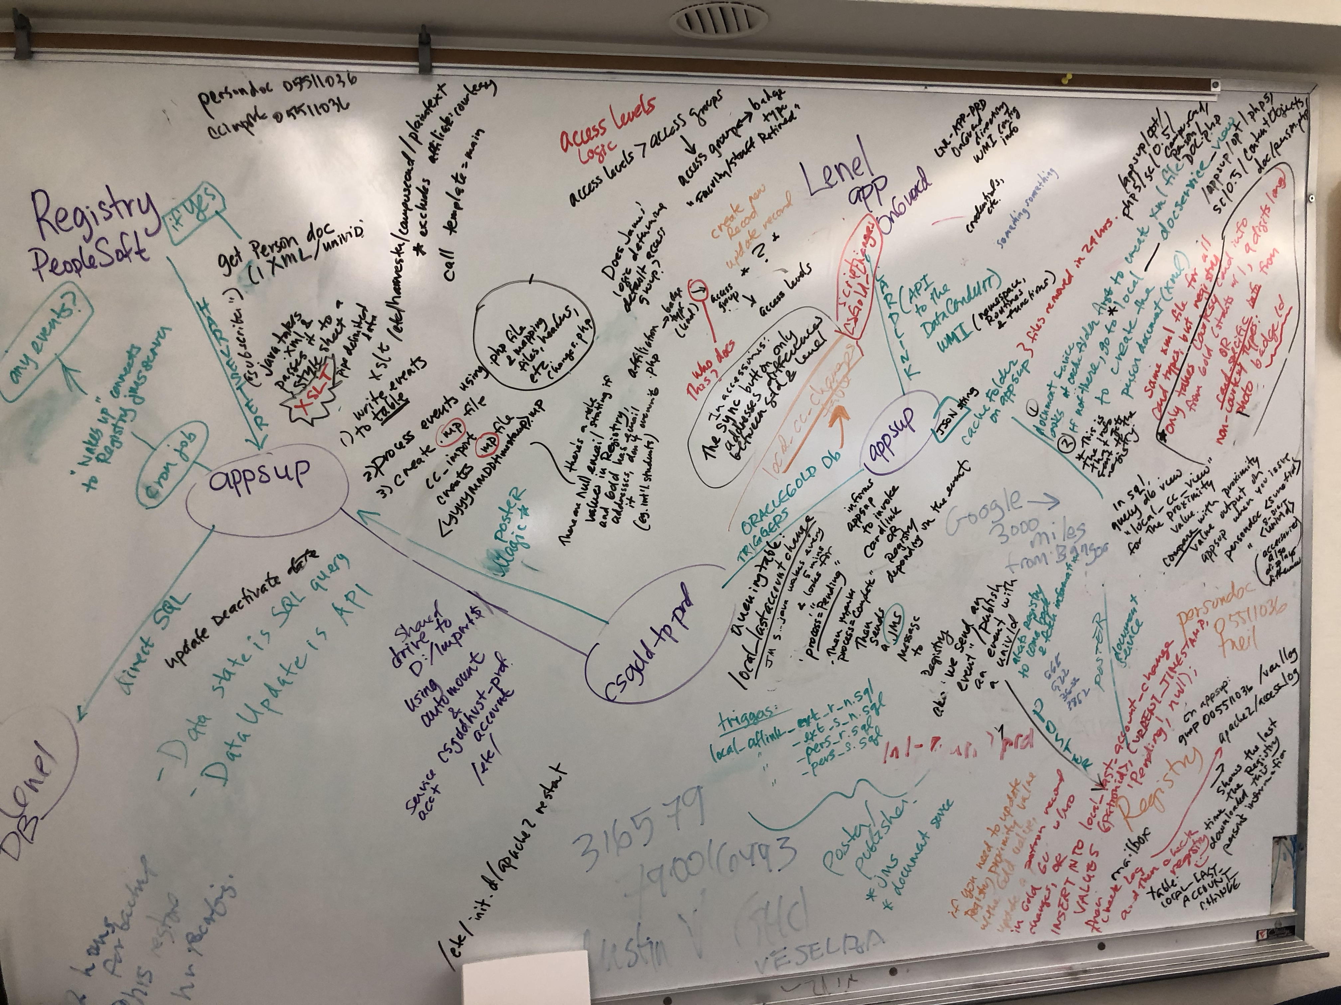
IMPLEMENTATION
Stanford Integrations

Slide 19
IMPLEMENTATION
Stanford Integrations
INTEGRATION TESTING
Bulk Access
Email Alerts
Photo Upload
Cardlink
R&DE
25Live
ALL Application Components…

Slide 20
IMPLEMENTATION
Close relationship with Lenel engineering
Secret weapon: Greg Bulger!

Slide 21
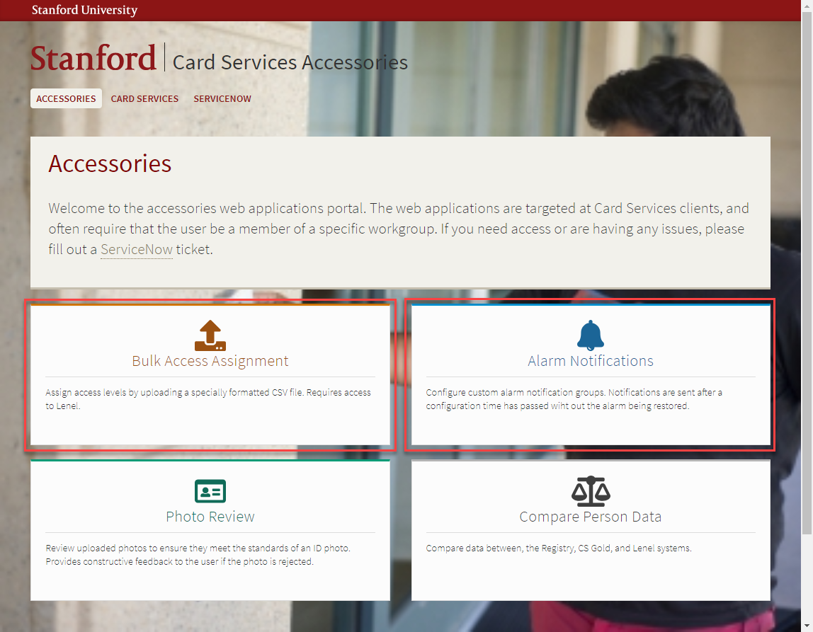
DEMO
Stanford Tools

Slide 22
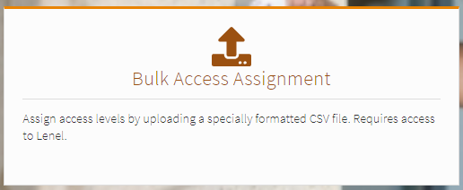
DEMO
Bulk Access Assignment:
https://accessories.stanford.edu/bulk/
Stanford Tools

Slide 23
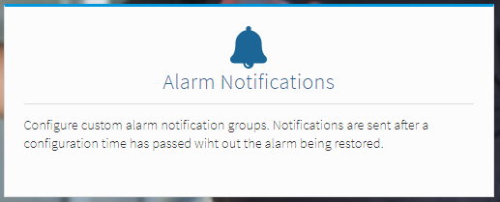
DEMO
Alarm Notifications:
https://accessories.stanford.edu/alerts/
Stanford Tools

Slide 24
IMPLEMENTATION
Project execution: well planned and tested.
Post upgrade monitoring and training sessions.

Slide 25
LESSONS LEARNED
Test, test, test!
Work closely with Lenel Customer Support and Northland
Plan for contingencies
Monitor services, logs, and Help Desk queue.

Slide 26

QUESTIONS AND DISCUSSION
Jose Rocha
Jonathan Randolph
Card Services
jrocha@Stanford.edu

