Slide 1
ID Card Billing from System Administration to Student Account
HELUG Conference June 26, 2018 Steve Cramer, Columbia University

Slide 2
Quick Survey - Do You?
Badge printing in Lenel?
Charge for cards?
Bill ID charges to student accounts?
Use Forms Designer to customize screens?
Utilize scheduled database jobs & triggers?

Slide 3
ID Charging at CU Before Project
Different systems required to print ID and record charge.
Lenel to print the card.
Excel to record the card to be charged.
Payments accepted
Cash
Credit card
Departmental charge
Voucher
Notes:
Departmental charge - visitors, vendors
Voucher - Barnard students pay their home school and then bring a voucher/receipt to the ID Center.

Slide 4
ID Charging at CU Before Project
We had to accept cash because:
Many students lost all of their credit cards along with their ID and could only could pay cash.
Billing to student account in Student Information System (SIS) was laborious.

Slide 5
Problems
No non-cash or credit card payment option for those who lost wallet or purse.
Cash payments prone to theft and poor accounting.
Double data entry slowed ID process.
Tracking unreliable.
Notes:
Overall, the payment system was inefficient, unreliable and most of all, service was slow and unfriendly. And we all know what slow and unfriendly looks like.

Slide 6
Slow & Unfriendly

Slide 7
Student ID Charging Project Goals
Improve tracking of all ID charges.
Eliminate cash payments
Enable direct billing to student account.
Do it all in Lenel if possible!

Slide 8
How Did We Do It?
Forms Designer
Added custom fields to Badge screen to record ID charges in the Badge table.
SQL Server
Added custom tables to AccessControl DB.
Utilized advanced functions to transfer ID charges entered in the Badge table over to SIS in a nightly batch process.
Notes:
Take backup. Watch out for blown away triggers.

Slide 9
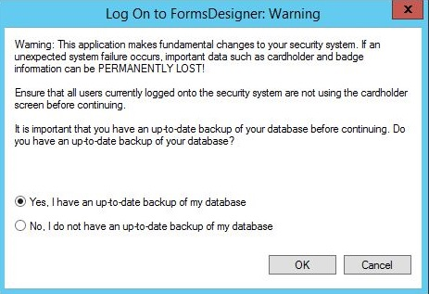
Forms Designer

Slide 10
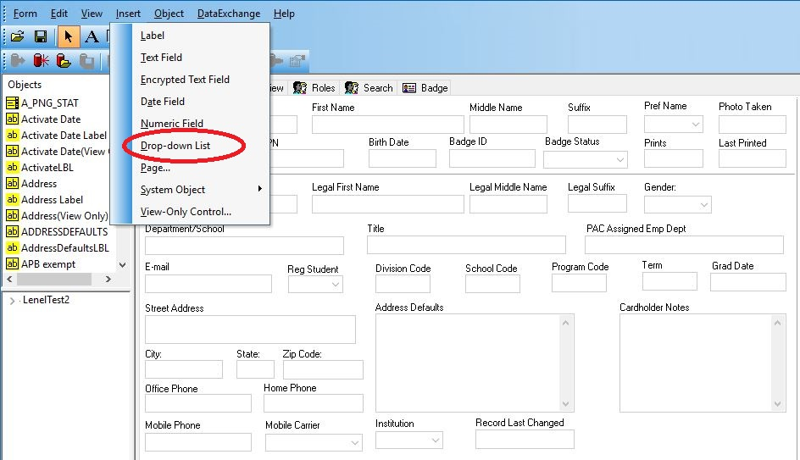
Forms Designer: Drop Down Pt1

Slide 11
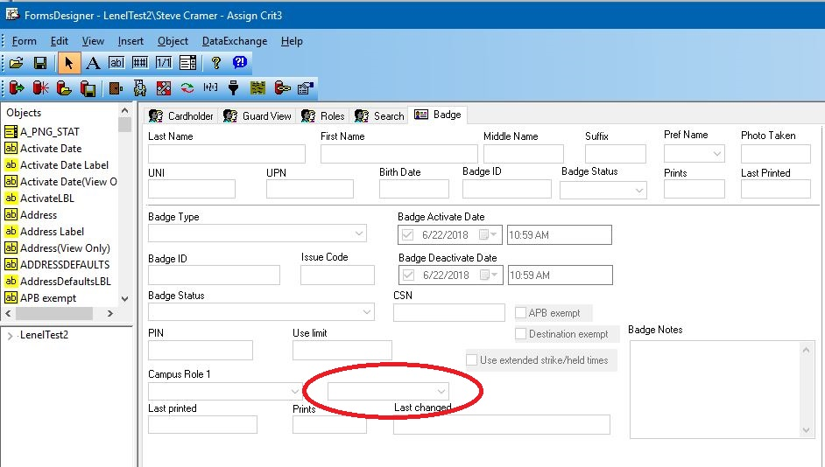
Forms Designer: Drop Down Pt2

Slide 12
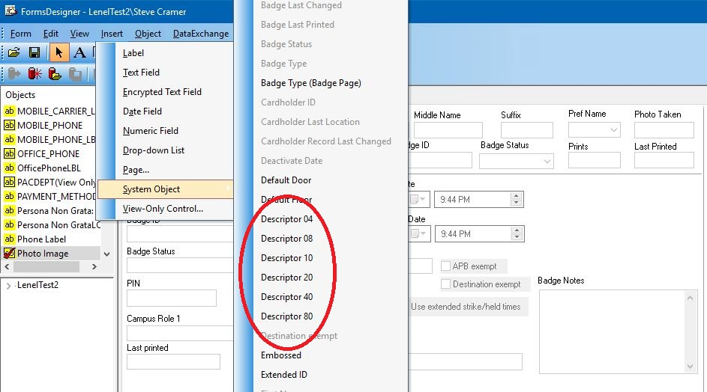
Forms Designer: Checkboxes Pt1

Slide 13
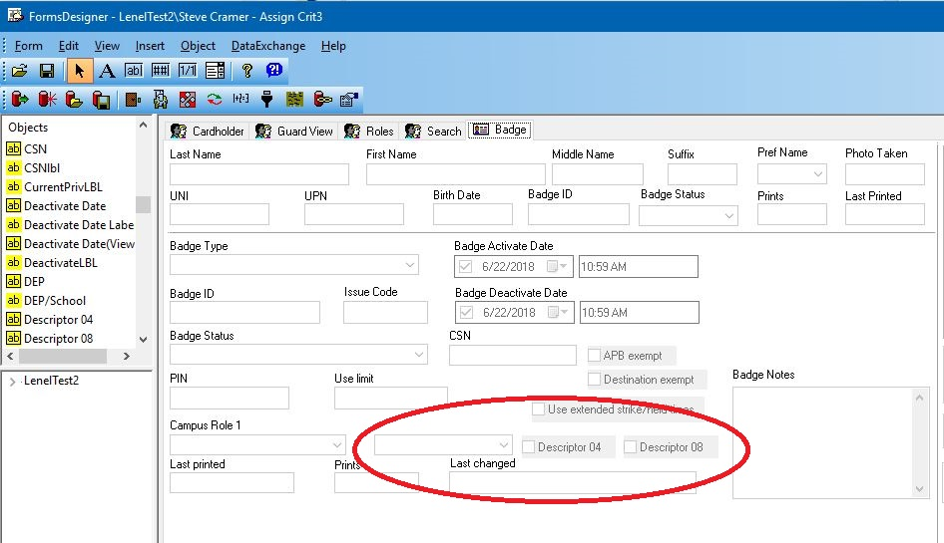
Forms Designer: Checkboxes Pt2

Slide 14
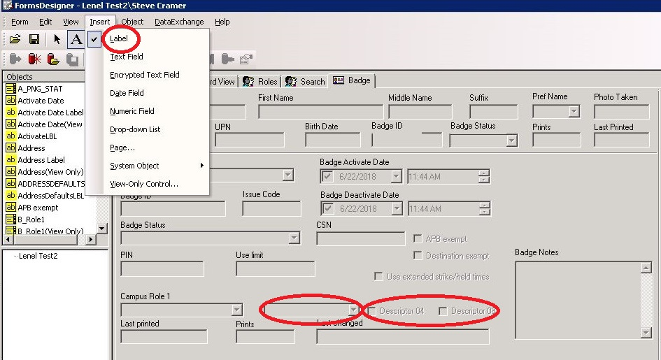
Forms Designer: Add Labels

Slide 15
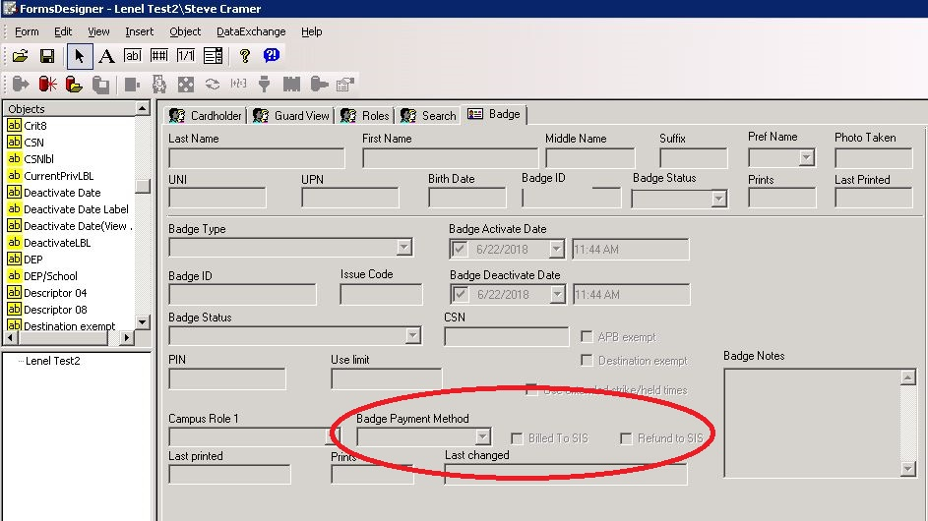
Forms Designer: Labels Added
Notes:
Be careful when using Forms Designer. Make sure you have a backup. Inform users

Slide 16
About Checkboxes
Each checkbox represents a unique binary value (4,8,16,32,64,128).
Sum of all checkbox values equals the total in Descriptor_Flag column in the Badge table.
Example:
Billed To SIS checked, Descriptor_Flag = 8
Refund To SIS checked, Descriptor_Flag = 16
Both checked, Descriptor_Flag = 24

Slide 17
About Checkboxes (cont.)
This is secret stuff. Not mentioned in Lenel User guide.
Don’t need full Forms Designer License to use them.

Slide 18
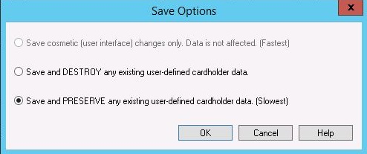
Forms Designer: Save and Preserve!
Notes:
Be careful when using Forms Designer. Make sure you have a backup. Inform users

Slide 19
Forms Change Tips
Instruct users not to make modifications while forms change is underway.
Before you begin:
Test change in test environment.
Save backup of database.
Use scripts to save your custom triggers in case you need to restore them.
When saving, never select Save and Destroy!

Slide 20
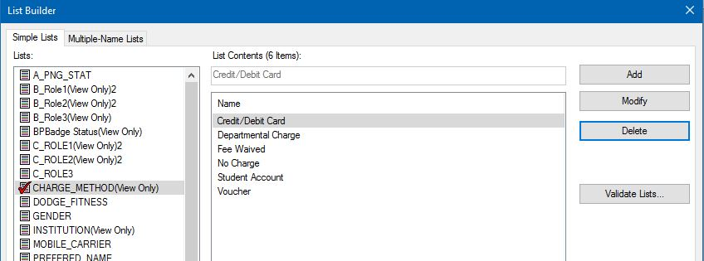
Add Payment Methods w/List Builder

Slide 21
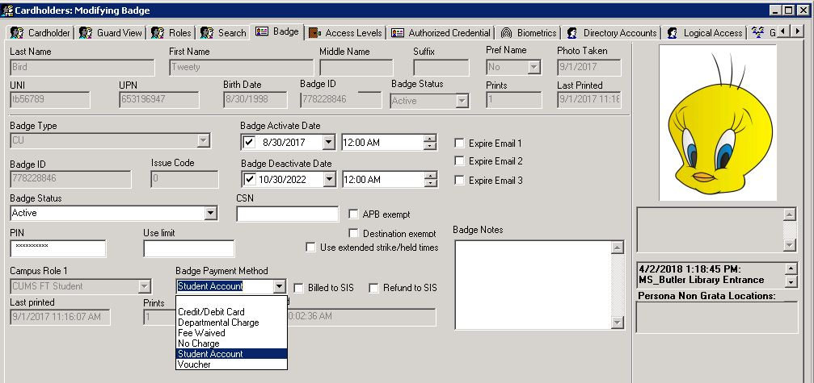
ID Charge Example: Charged

Slide 22
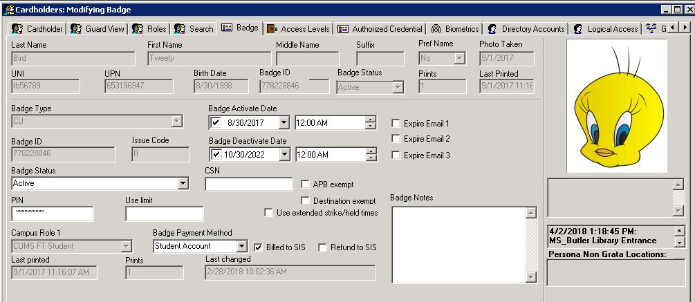
ID Charge Example: Billed to SIS
Notes:
That completes the user interface part of the solution. Now lets look inside SQL Server and see how we are making it work with our access control database.

Slide 23
Inside SQL Server

Slide 24
SQL Server Components
Database tables
Triggers
Action performed in response to a change in a specific database table.
Jobs
Automated and often scheduled series of database operations that together form a single process.
SQL Server Integration Service Services (SSIS)
SQL Server component that can be used to perform a variety of data migration tasks.

Slide 25
ID Charge Tables
UDO_ID_CHARGE
UDO_ID_CHARGE_BATCH_ID
UDO_ID_CHARGE_BILLING_TEMP
UDO_ID_CHARGE_BILLING_BATCH
UDO_ID_CHARGE_SIS
UDO_ID_CHARGE_JOB_RUN_LOG
Notes:
Re ID Charge -- Did not want to overload Badge table with extra columns and processes. Best to store minimum there and create a separate table to handle the bulk of the operations -- recording amount charge, emailed sent, billing date, batch number, etc.

Slide 26
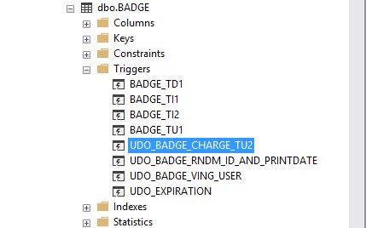
ID Charge Trigger on Badge Table

Slide 27
ID Charge Trigger (cont.)
Update trigger on Badge table.
Compares values before and after an update in Badge table.
Only acts after badge has been printed.
If printed, trigger enters new record in ID Charge table.

Slide 28
ID Charge Trigger (cont.)
Looks for changes to the Badge Payment Method, Billed to SIS and Refund to SIS fields.
Allows change of Payment Method before Billed to SIS is checked.
Enforces locking of Payment Method after Billed to SIS is checked.
Detects checking of Refund checkbox.
Executes email receipt to students when Student Account selected as payment.

Slide 29
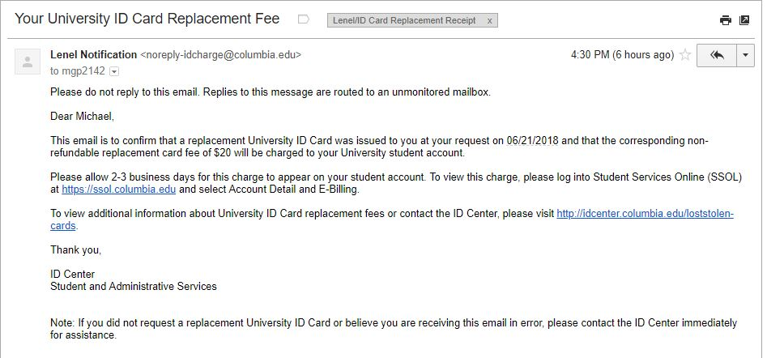
Email Notification

Slide 30
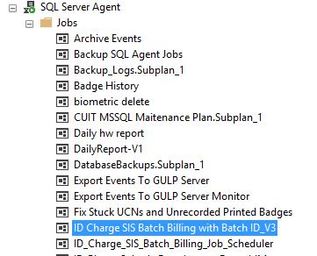
SQL Server ID Billing Job

Slide 31
SQL Server ID Billing Job (cont.)
Insert ID charge records that have not yet been billed to SIS into Billing Temp table.
Using SSIS, export Billing Temp records into text file in expected batch format.
Using PowerShell and WinSCP, transfer text file to deployment server.
Job scheduler processes and uploads text file into SIS for billing.

Slide 32
SQL Server ID Billing Job
Update Badge and ID Charge tables to confirm charges processed by Lenel.
Query SIS to check if charges sent were actually billed to student accounts.
If yes, update ID Charge table to confirm billing.

Slide 33
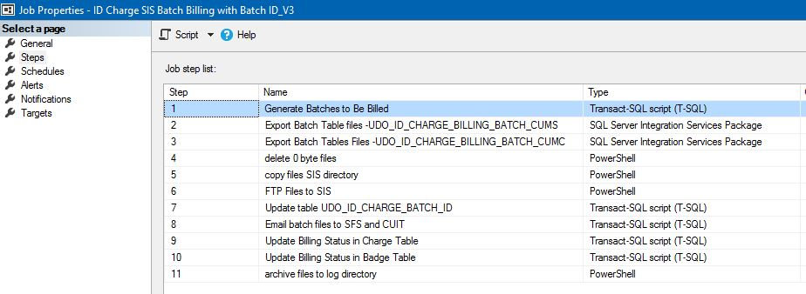
SQL Server ID Billing Job Steps

Slide 34
Project Results
Made ID charge processing, billing and tracking much faster and more accurate.
Students really like account billing option.
Since 2014
20,000+ student charges.
65% billed to student account.
$280,000

Slide 35
Lessons Learned
Make sure you have a refund process.
Create a manual and train staff well.
Triggers can be tricky.
Watch out for recursion.
Update trigger can get caught in a loop updating itself.
Test! Test! Test!
Beware of holidays!

Slide 36
Final Thoughts
SQL Server & Forms Designer are a powerful combination but must be used wisely.
Lots of other cool things you can do:
Checkboxes for email notifications for expiring cards.
Note field on the Badge or Cardholder tab.
Dropdown box on Cardholder tab to initiate record refresh from Identity Management System.

Slide 37
Questions

Slide 38
Contact Information
Steve Cramer
steve.cramer@columbia.edu
(212) 854-3140

