Slide 1
Lenel Maps - Stanford
Jonathan Randolph
Higher Education Lenel User’s Group – June 26, 2018

Slide 2
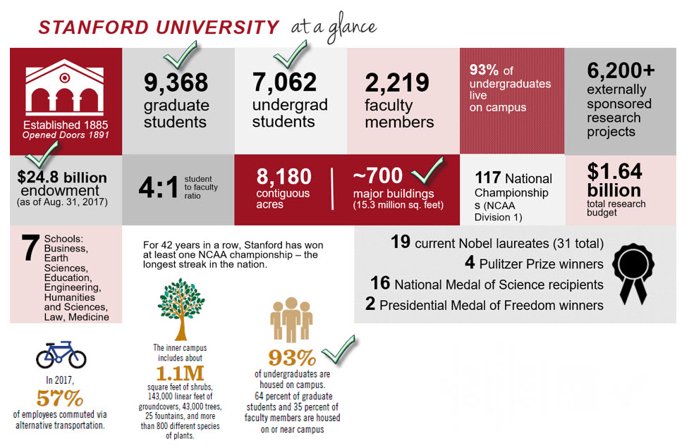

Slide 3
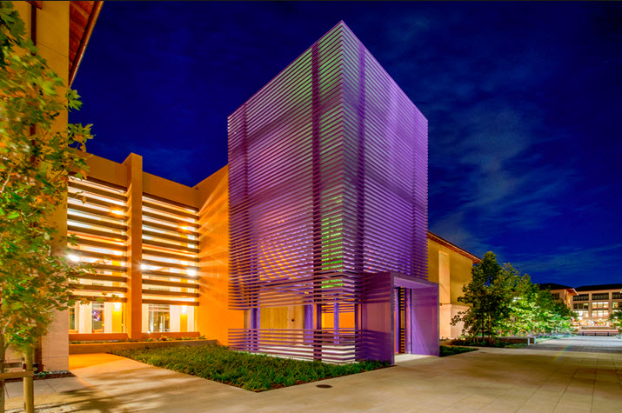
-Lenel OnGuard v7.3-
Windows Server 2012 R2
1 application server
7 communications server
2 RDS servers
1 database server
(MS SQL 11.0.6615.2)
The GSB Residence Building

Slide 4
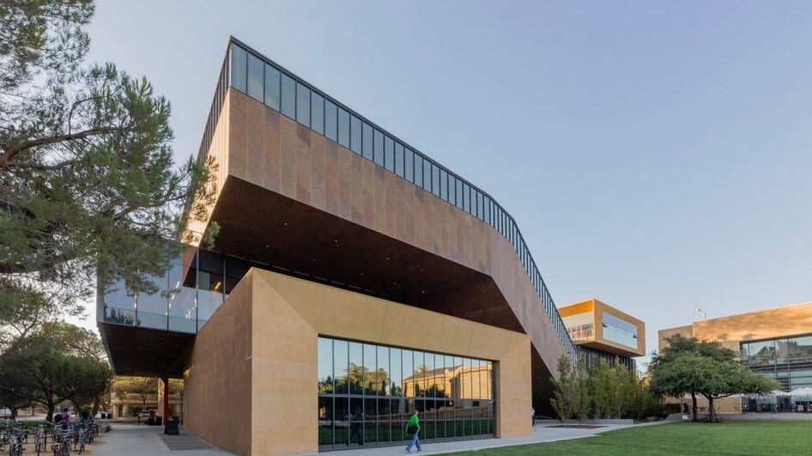
About Our Deployment
306 buildings use Lenel OnGuard
1408 panels:
361 LNL-3300
14 LNL-2220
15 LNL-2210
447 lnl-1200
361 lnl-1100
210 ILS WAPS
3012 doors:
2591 wired locks
421 wireless locks
80,000+ Active cardholders
75 Segments – 470 system users
How many maps ???
The McMurtry Building

Slide 5
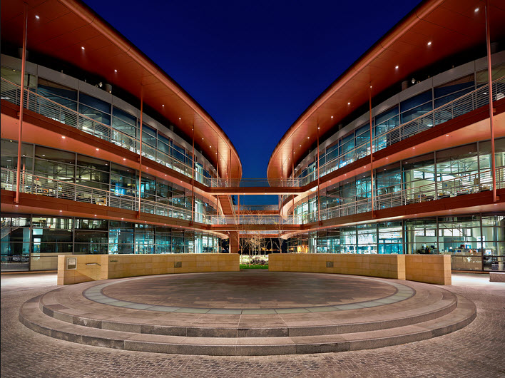
631
The Clark Center

Slide 6
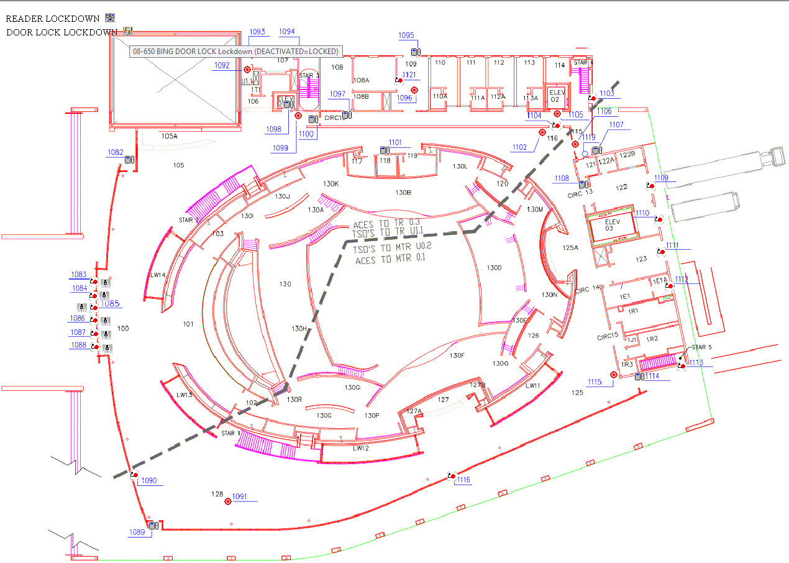

Slide 7
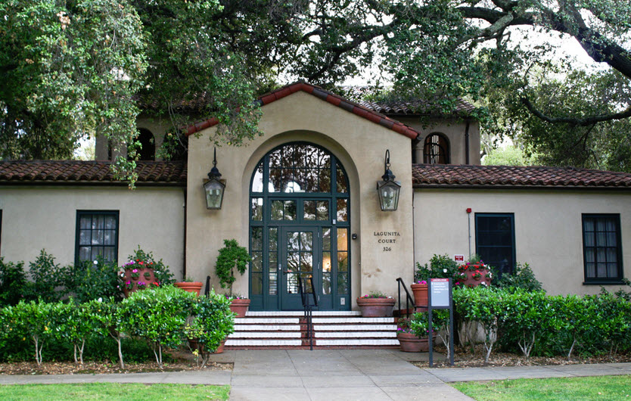
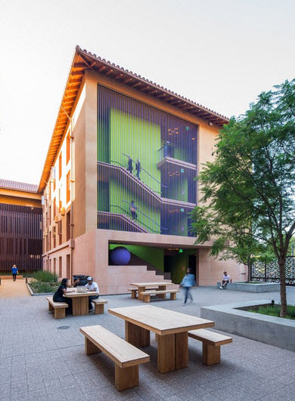
Who is using the maps in Lenel?
UIT University Techs Technicians
UIT Operations Center

Slide 8
Everyone:
Changes the mode of doors using maps (System tree or Map selection)
Most:
Use the maps to help other personal to navigate to door locations and troubleshoot issues
Very few:
Have ever used a building lockdown (PHEW!!)
Actively monitor alarms in Alarm Monitoring
No one:
Uses “Floating” mode
Interior of Memorial Church

Slide 9
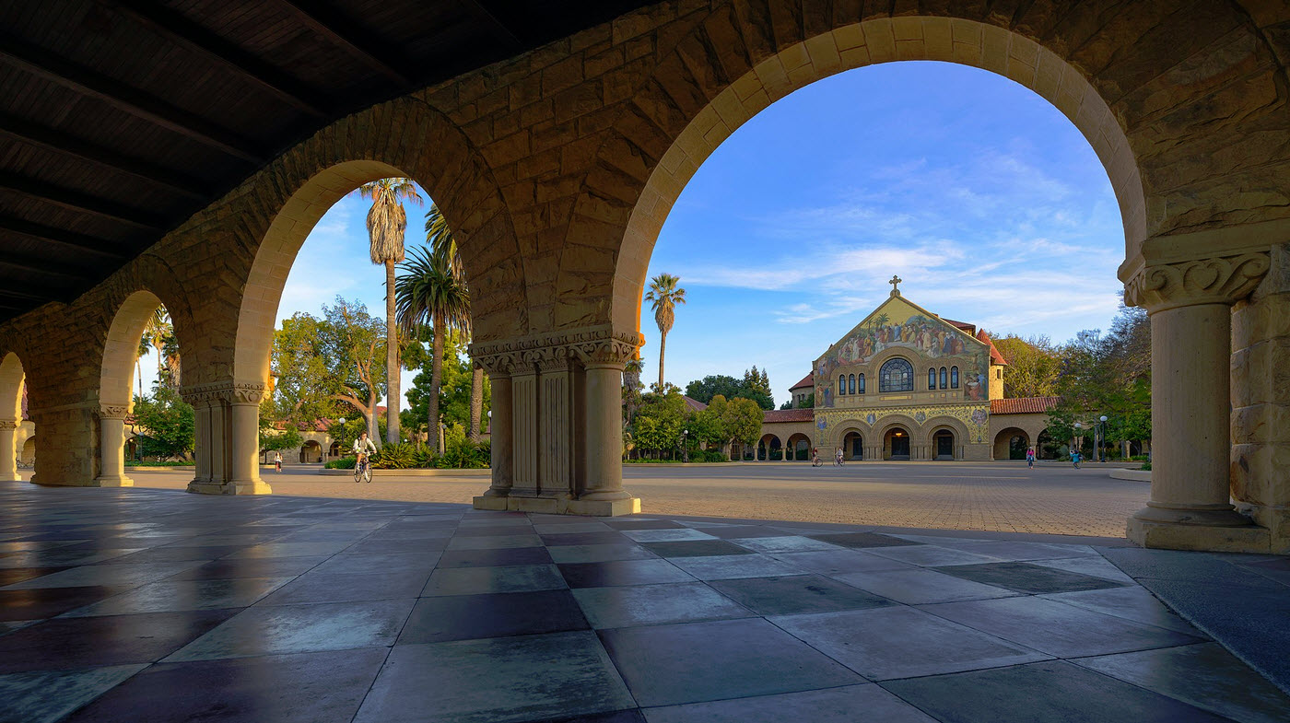
Additional features & functionality (wish list)
Have the ability to have multiple maps open at once
Would like an easier way to jump to other floors of a building while within a complex
If a reader is assigned a TRM have the timezone pop up when hovering over a reader
Have the ability to launch Alarm Monitoring from System Administration
The ability to make updates to maps from a web page
Improve user experience with Alarm Monitoring when using mobile devices
Memorial Church walkway

Slide 10
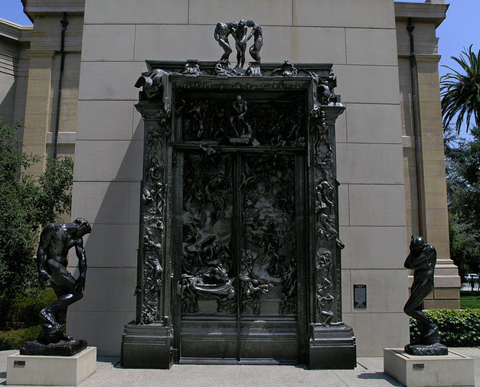
Questions?
The Gates of Hell by Rodin

Slide 11
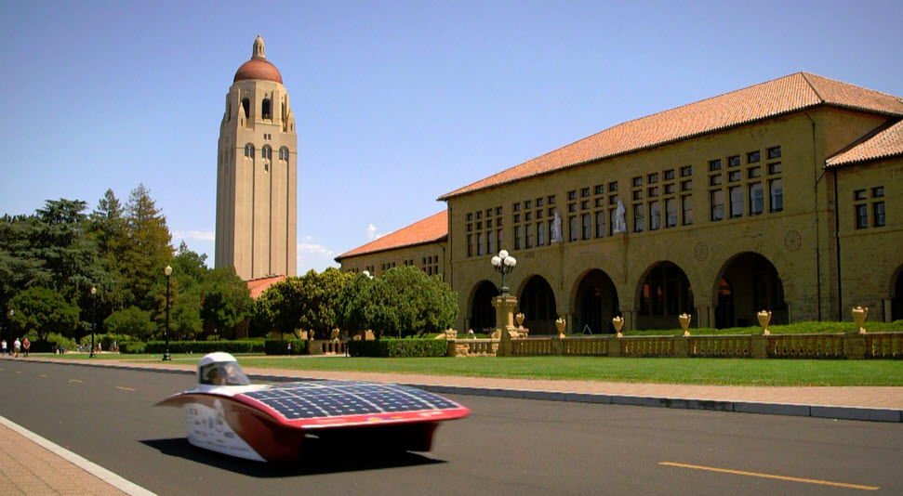
Thank You!
Hoover Tower and Wallenberg Hall

