Slide 1
Are you vulnerable to attack?
Lenel panel vulnerabilities – 2 stories

Slide 2
SWEET32!
POODLE!
Bonjour!
Bar Mitzvah!

Slide 3
How Vulnerable are you?
Your Turn! (Audience Participation)
Notes:
How many of you know the login/passwords for your Lenel Panels?
How many of you have a tool that scans for vulnerabilities? Or has an ISO office or 3rd party that does?
Do you know what version of TLS you are running? Does your vendor? Why is it important?
Where do you think you fall in a category of preparedness? Category 1 – Not prepared, Category 2 – maybe getting there?, Category 3 – Bring it on!

Slide 4

Arizona State University’s eye opener
The POODLE attack (which stands for "Padding Oracle On Downgraded Legacy Encryption") is a man-in-the-middle exploit which takes advantage of Internet and security software
SWEET32 Birthday Problem - The birthday paradox, also known as the birthday problem, states that in a random gathering of 23 people, there is a 50% chance that two people will have the same birthday.
Bonjour provides a general method to discover services on a local area network. The software is widely used, and allows users to set up a network without any configuration. As of 2010 it is used to find printers and file-sharing servers.
Bar Mitzvah is when Jewish boys become 13 years old, they become accountable for their actions. The attack leverages a 13-year-old weakness in the less secure Rivest Cipher 4 (RC4) encryption algorithm

Slide 5
3rd party cybersecurity scan discovered 11 vulnerabilities on 17 of our panels!
Vulnerability | Rating
SNMP Agent Default Community Name (public) | High
SSL Certificate Chain Contains RSA Keys Less Than 2048 bits | Low
SSL Certificate Signed Using Weak Hashing Algorithm | Medium
SSL Certificate Cannot Be Trusted | Medium
SSL 64-bit Block Size Cipher Suites Supported (SWEET32) | Medium
SSL Medium Strength Cipher Suites Supported | Medium
SSL Version 2 and 3 Protocol Detection | Medium
SSL Weak Cipher Suites Supported | Medium
SSLv3 Padding Oracle On Downgraded Legacy Encryption Vulnerability (POODLE) | Medium
SSL RC4 Cipher Suites Supported (Bar Mitzvah) | Medium

Slide 6
What!!! Who can help?
ASU INTERNAL:
3/30/2018 – assumption it was a server issue then identified them as LNL panels not servers
INTEGRATOR:
4/2/2018 – did our integrator cause this? how do they solve it?
  Integrator – no knowledge of why some panels not all and blamed firmware
  Integrator – no knowledge of guidelines or any white paper
  Integrator – requested assistance from Lenel’s Regional Sales Manager
4/10/2018 – call out to peers on HELUG
  Received response but no written documentation of official guidelines
4/13/2018 – Conversation with Lenel
  Integrator – provided Mercury Hardening Guide
NETWORK PROVIDER:
4/18/2018 – ACLs were applied across all panels

Slide 7
Cyber Cops! - Information security office
“ISO: The ACL update is good, but all vulnerabilities need to be remediated. The weaker TLS certificates are less of a concern, but SNMP (public) enabled is not best practice and should still be addressed”
1 week to mitigate HIGH
1 month Medium

Slide 8
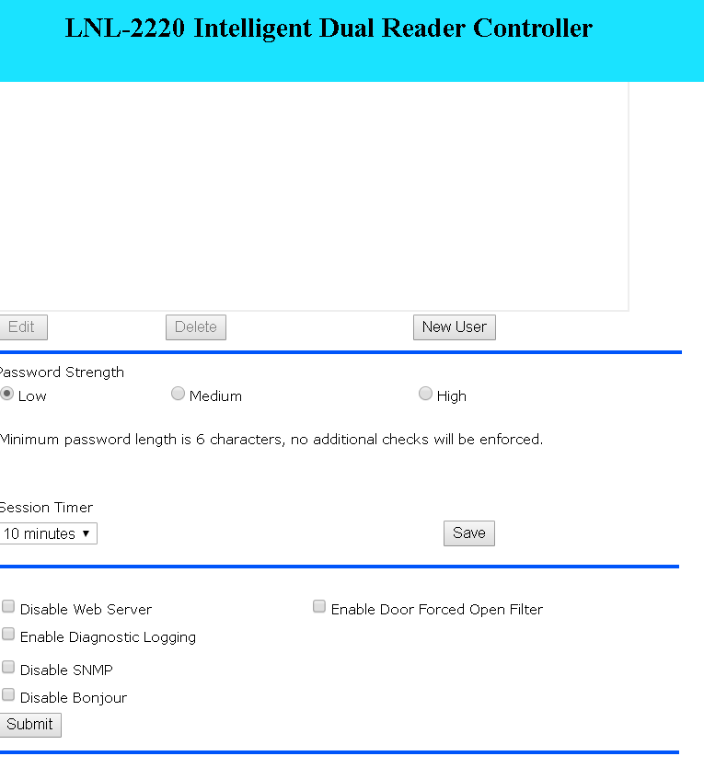
**Note: Making the changes below will cause the panel to reboot. **
We have tested these setting with Lenel OnGuard and the three settings do not affect the performance of the OnGuard application.
You should be able to address the SNMP vulnerability concerns by navigating to the web page in each Series 2 or newer Lenel panel and check the ‘disable’ boxes at the bottom:
Disable SNMP This should eliminate the primary vulnerability you reported.
Disable Bonjour The Mercury / Lenel discovery tool will no longer find the panel or be able to configure it, but this is low impact and eliminates potential vulnerabilities.
Disable Web Page This disallows ALL further configuration on the panel so do not do this unless you are sure that you need to eliminate an immediate vulnerability.
DEFAULT SETTINGS
Commitment needed to train field technicians on best practices RATHER THAN LEAVING DEFAULT SETTINGS!

Slide 9
Execution and impact
EXECUTION
500 panels
1 – 20 minutes per panel
  1000 Hours worst case
  16.6 hours
  Must be done at a time of least impact to the building
Need upper management commitment to move forward due to impacts!
IMPACT
Summer classes (classrooms)
  Daytime use/Nighttime execution
Conference attendees (Res Halls)
  Nighttime safety/Daytime execution
Manpower
  2 people
Communications Plan
  10 days prior
  Building Managers and police on alert

Slide 10
Resources
  Mercury Hardening Guide (copy available for attendees)
  https://mercury-security.com/news/mercury-hosts-sia-panel-on-cyber-hardening-access-control-systems-at-isc-west-2018/
  https://mercury-security.com/news/cyber-security-the-internet-of-things/

Slide 11




Stanford university
University IT
Information Security Office (ISO) – Partnership in Security
Minimum Security Standards – Our Holy Commandments
Qualys scanning tool – Portal and reporting features

Slide 12
Stanford university - Information Security office (ISO)
“Stanford is committed to protecting the privacy of its students, alumni, faculty, and staff, as well as protecting the confidentiality, integrity, and availability of information important to the University's mission.”
“All of us share responsibility for protecting Stanford systems and data from unauthorized access.”

Slide 13
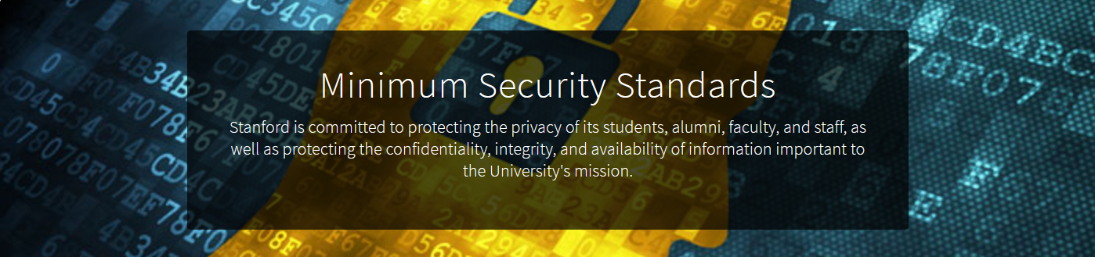

Slide 14
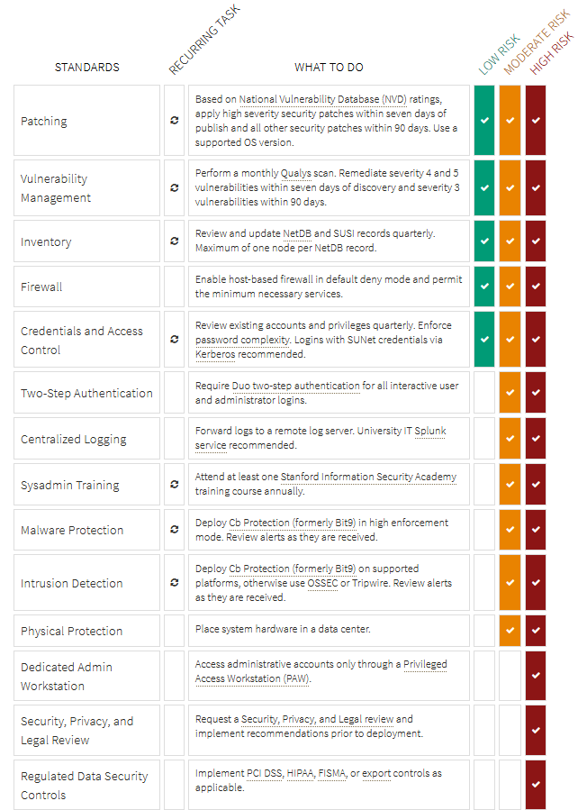
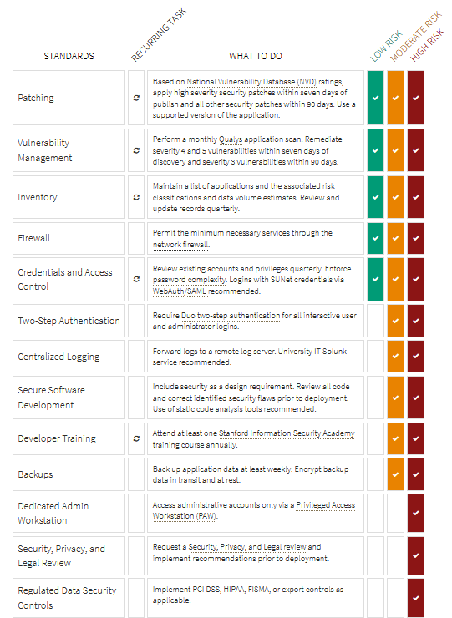



Slide 15
The history of Qualys at Stanford – Yikes !! It’s the 1st of the month !!
Portal provides the ability to run On-Demand scans of hardware
Historical scan data
Customized scan schedules
Threat, Impact and Solutions !!!

Slide 16
DEMOS

Slide 17

QUESTIONS ???

Slide 18


Thank you !!!
Laura Ploughe – Arizona State University
LAURA.PLOUGHE@asu.edu
Jonathan RANDOLPH - Stanford university
JRANDOLP@STANFORD.EDU

